Slide 1
Point of Sale Microservices
A Cloud-Native Microservices Application

Slide 2
Project Theme
Modern point of sale (POS) system.
Designed for retail transactions and inventory management.
Supports seamless customer loyalty integration.
Microservice architecture
Inventory Service: Manages products, vendors, and purchase orders.
Loyalty Program Service: Tracks customer loyalty accounts and rewards.
Point of Sale (POS) Service: Handles retail transactions, registers, employees, and customer transaction history.

Slide 3
Project Theme
Scalability and Maintainability
Decoupled service for independent scaling and updates.
Supports future expansion with additional services.
Cloud Native and Containerized
Uses Spring Boot and Spring Cloud for microservices.
Deployed via Docker and managed with Docker Compose.

Slide 4
Project Theme
Centralized Configuration Management
Spring Cloud Config Server ensures consistent settings across environments.
Configuration stored in a dedicated Git repository for version control.
Real-World Application
Designed for businesses needing robust transaction, inventory, and customer loyalty solutions.
Flexible and extensible for diverse retail environments.

Slide 5
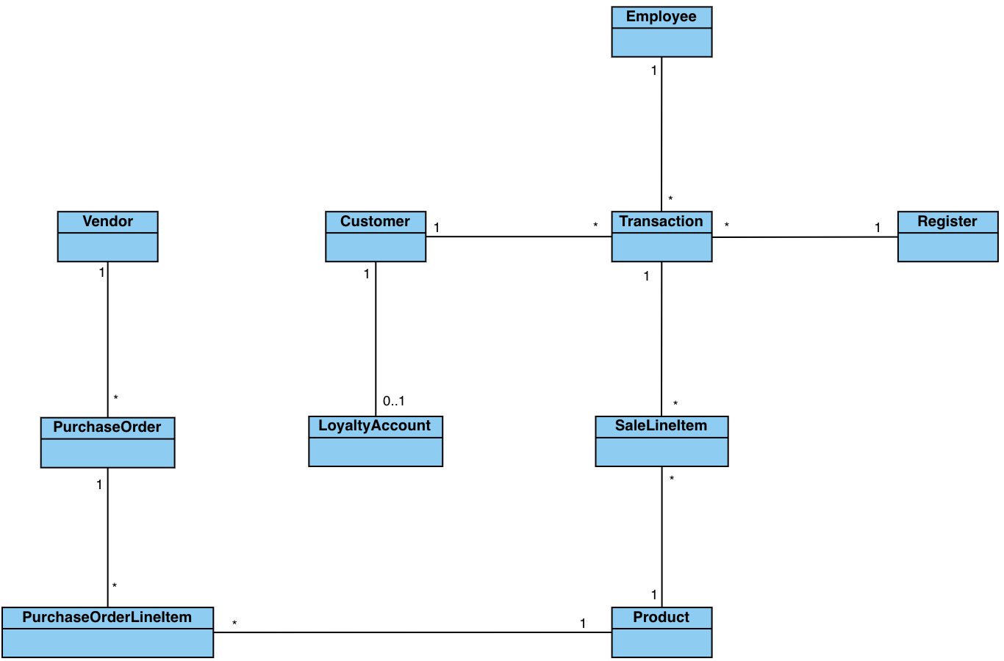
Canonical Model

Slide 6
Canonical Model
The canonical model was analyzed against business functions to develop the bounded contexts of the application:
Identified business functions
Retail transactions and management
Inventory management and vendor management
Loyalty and rewards tracking
Can be extended to add additional features, such as targeted marketing communications

Slide 7
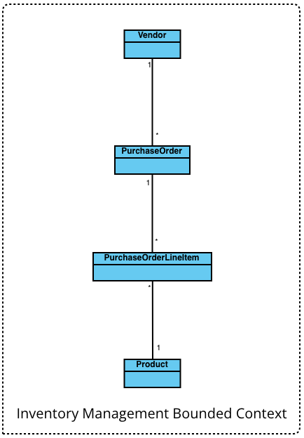
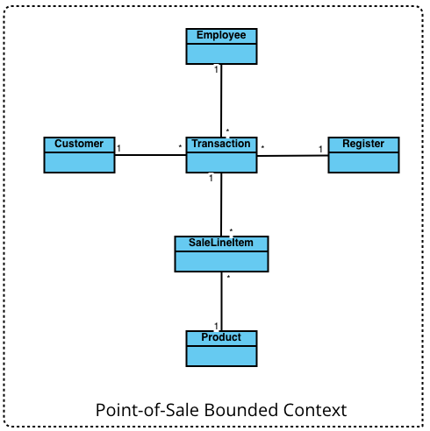
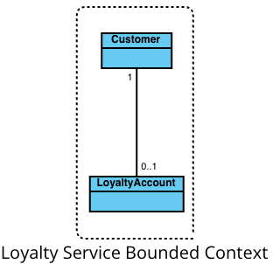
Bounded Contexts

Slide 8
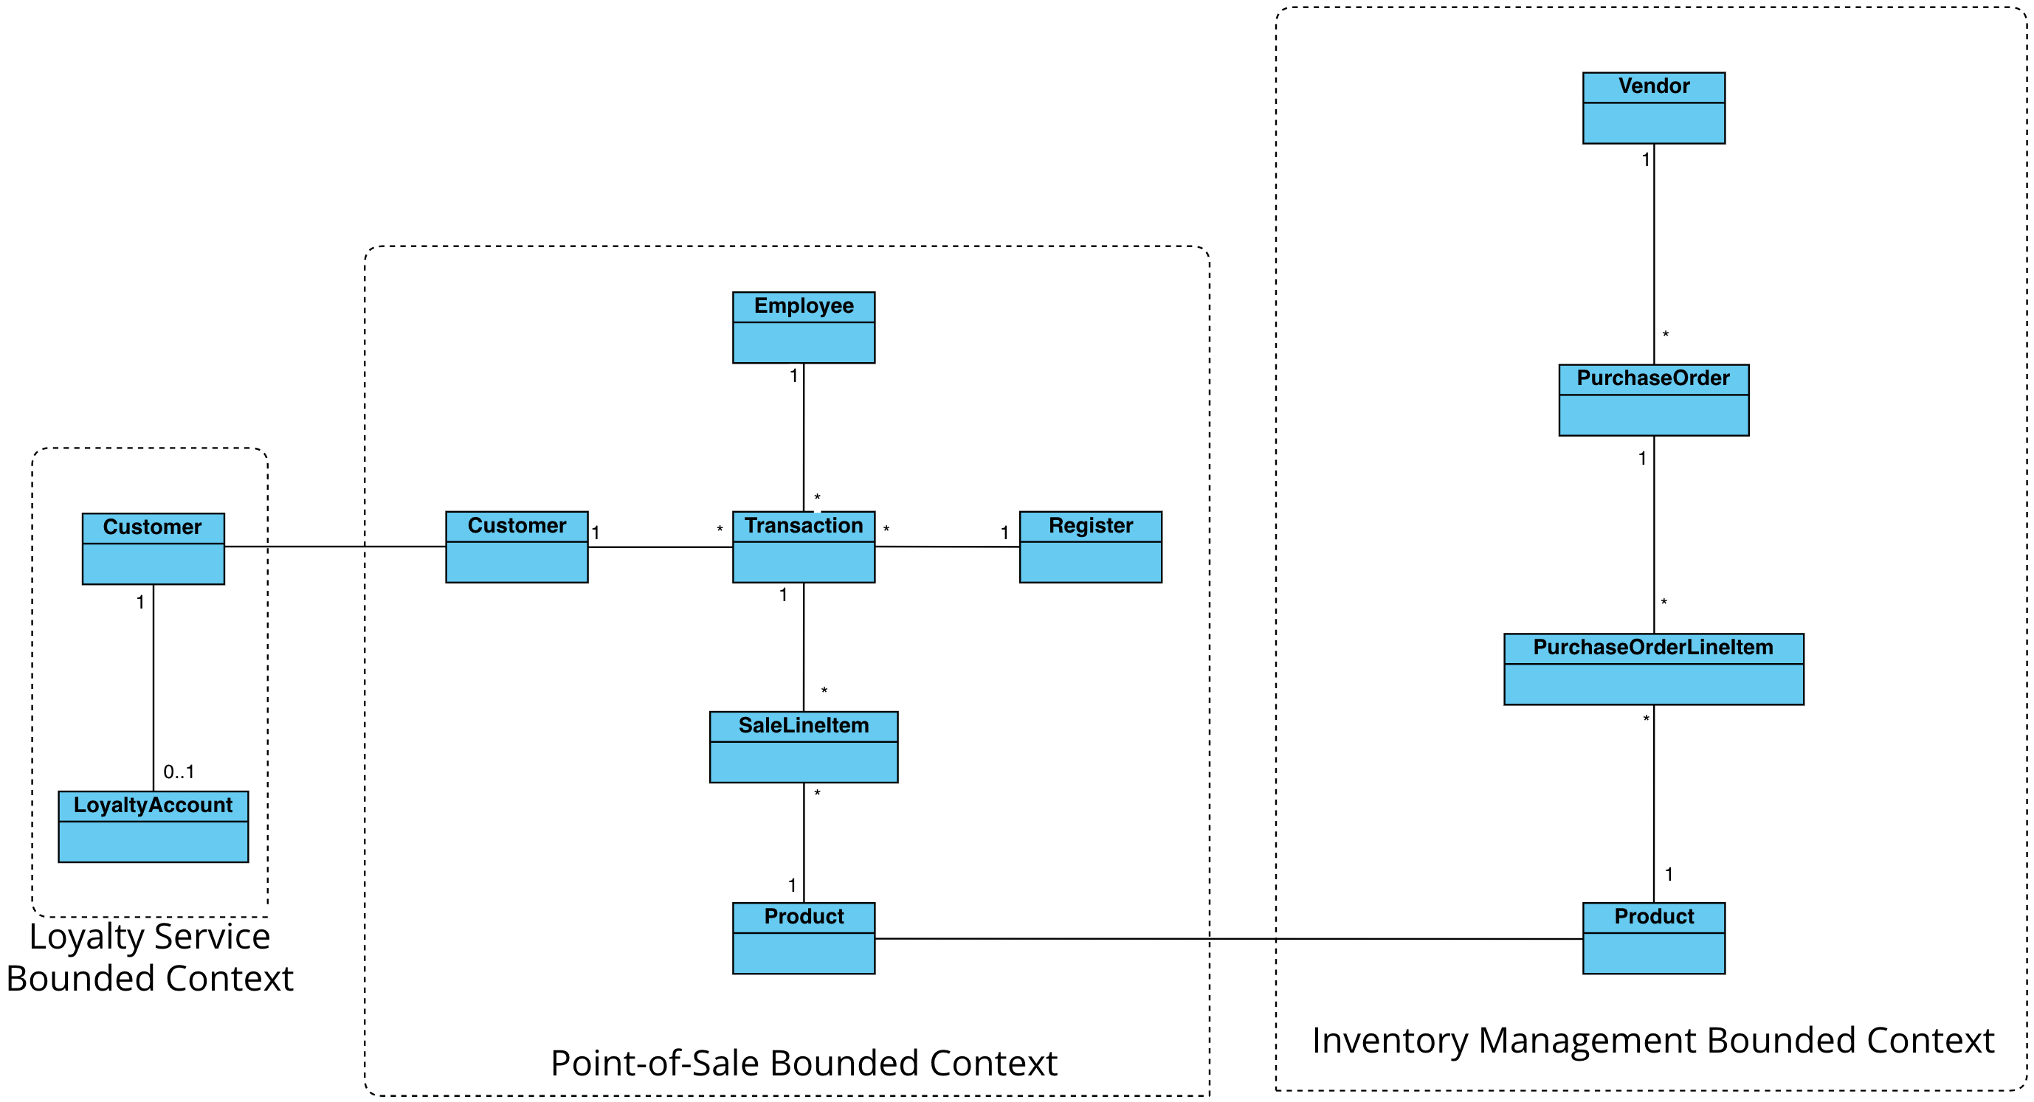
Context Map

Slide 9
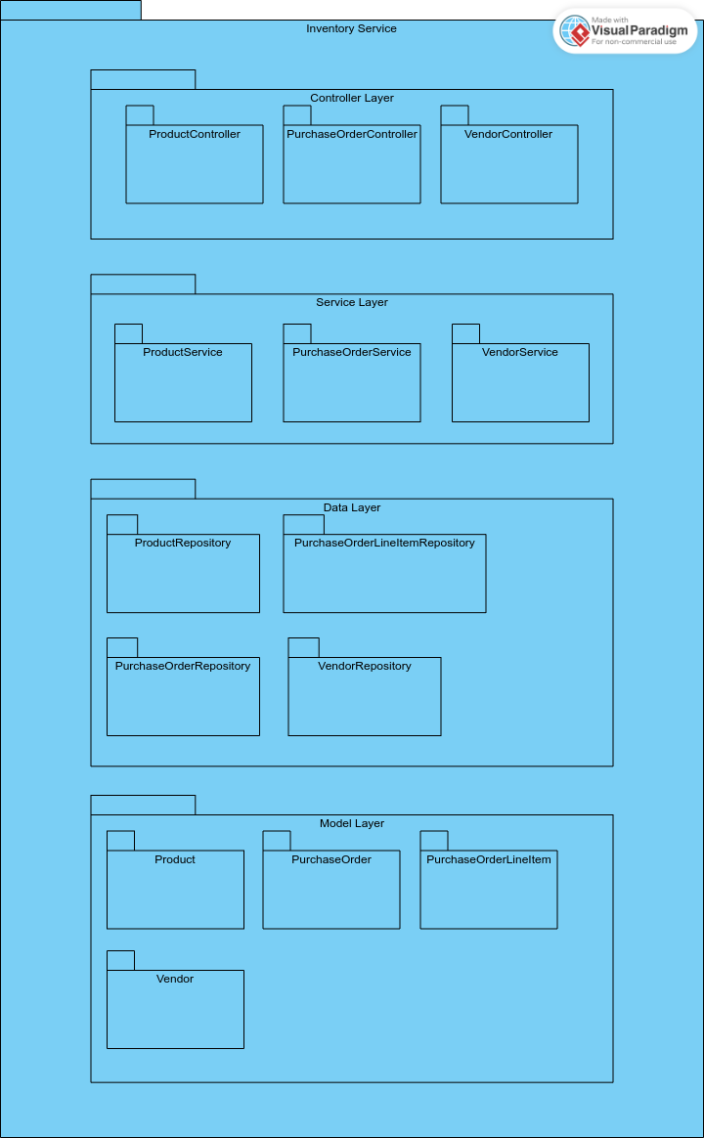
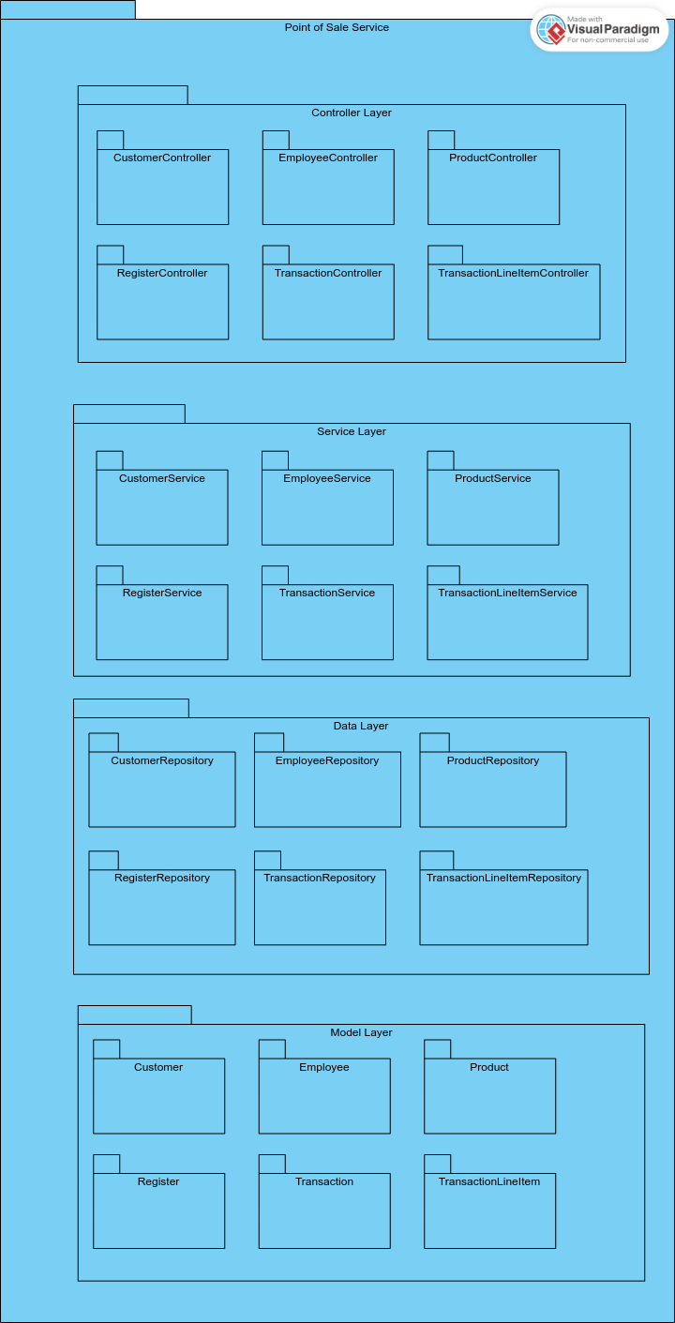
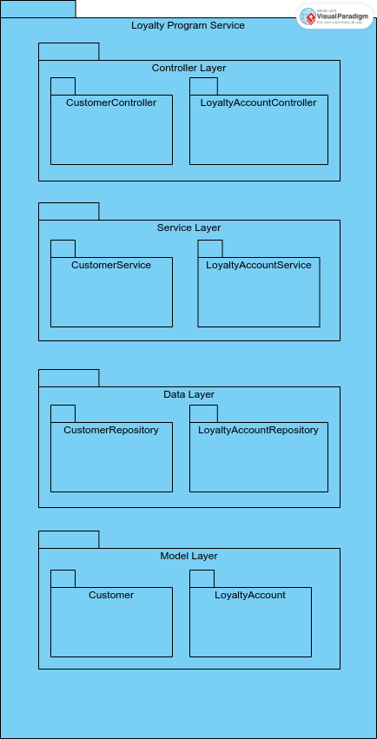
Package Diagram

Slide 10
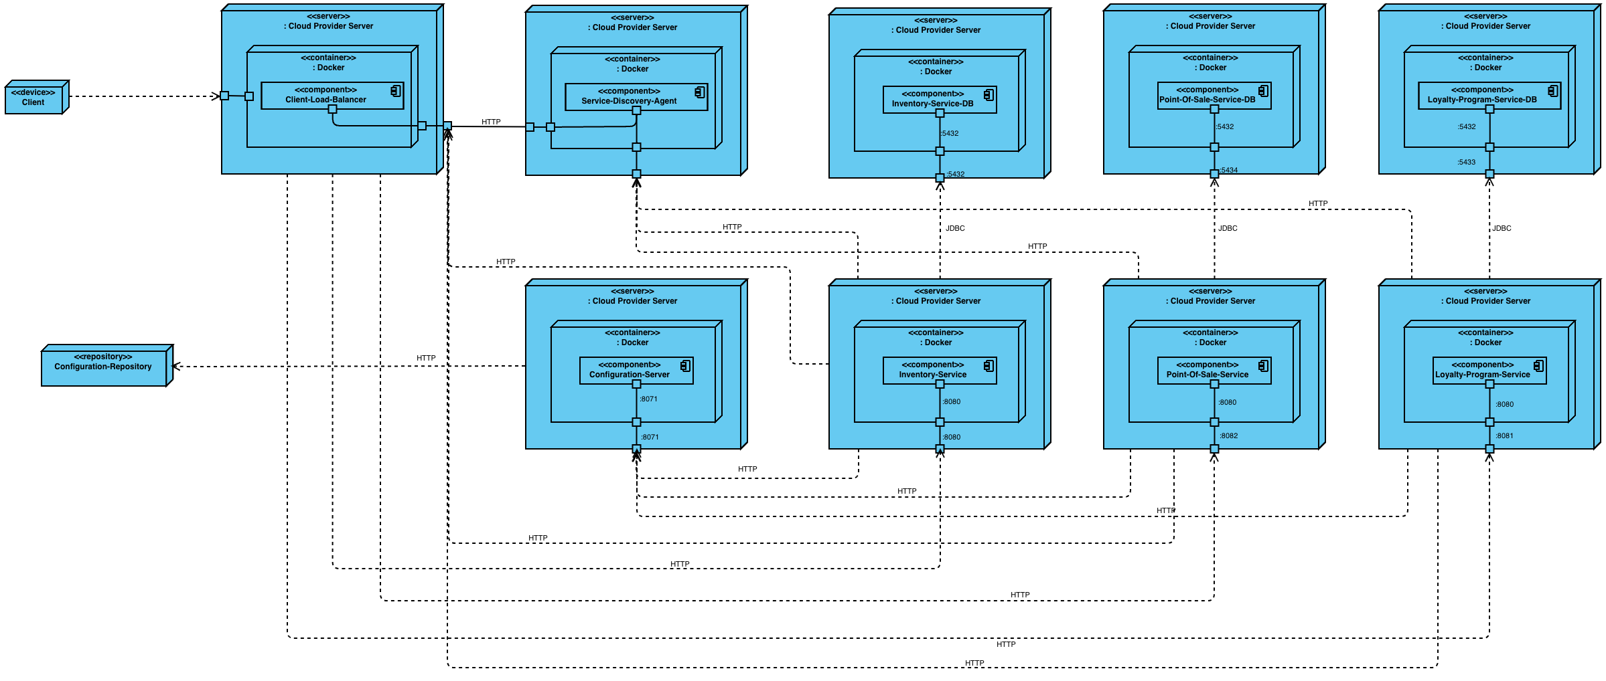
Deployment Diagram

Slide 11
Updates Since Checkpoint 1
Implemented Service Discovery
Utilized Feign clients between services
Added Gateway in front of the services
Integrated the correlation-id
Added Keycloak for security
Implemented Gatling tests for common calls into services

Slide 12
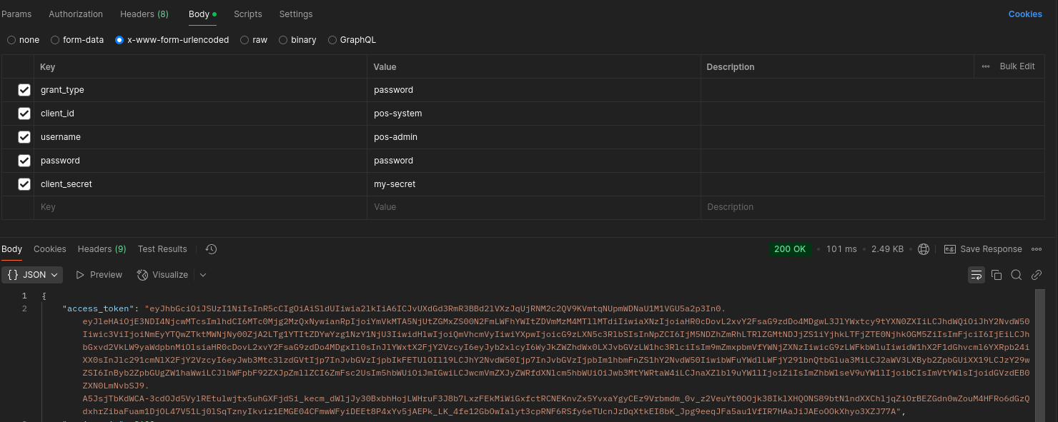
Authentication

Slide 13
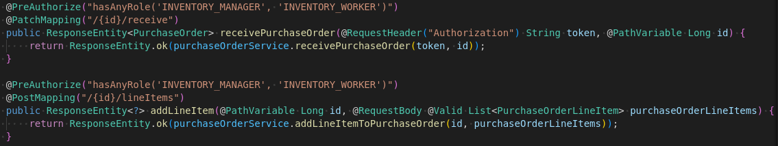
Authorization

Slide 14
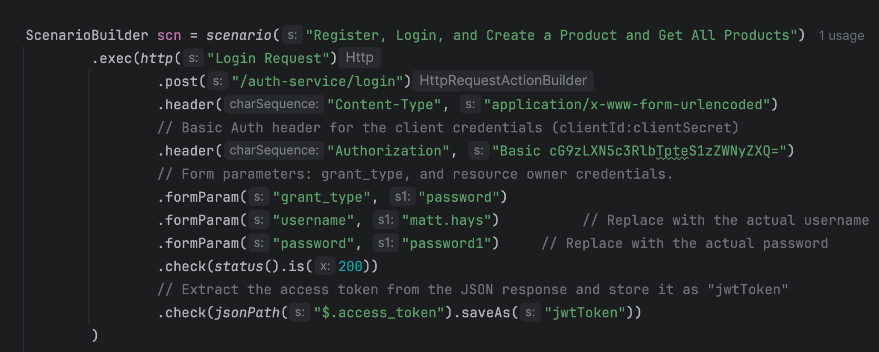
User Generation

Slide 15
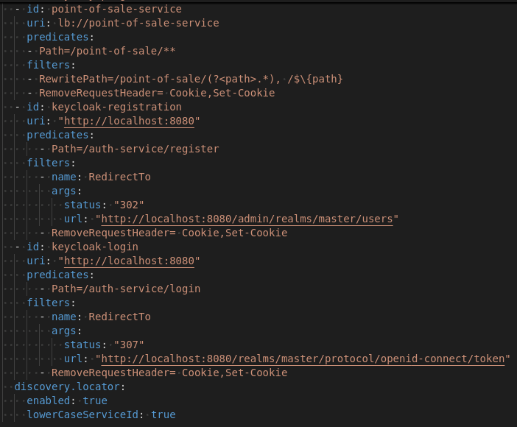
Bearer Token Passing

Slide 16
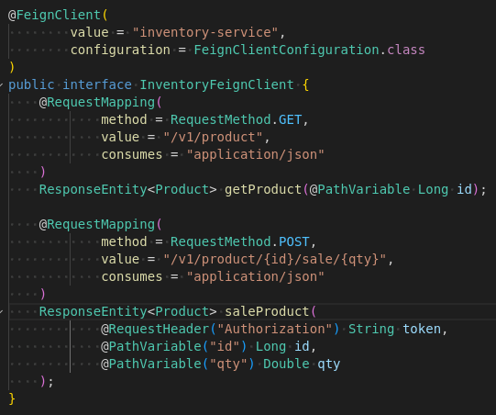
Service Discovery and Feign Clients

Slide 17
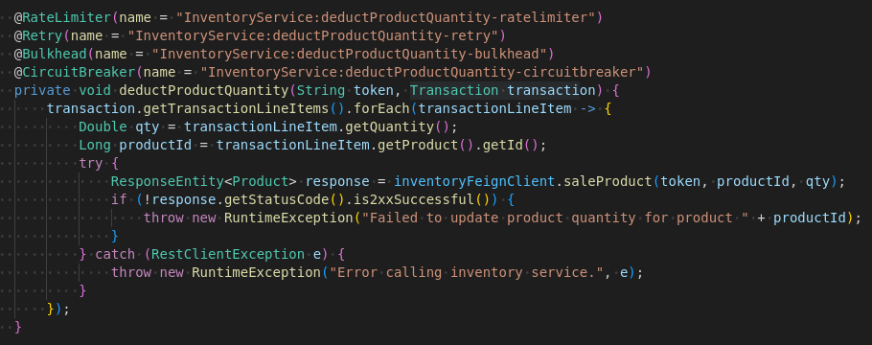
Resilience Patterns

Slide 18
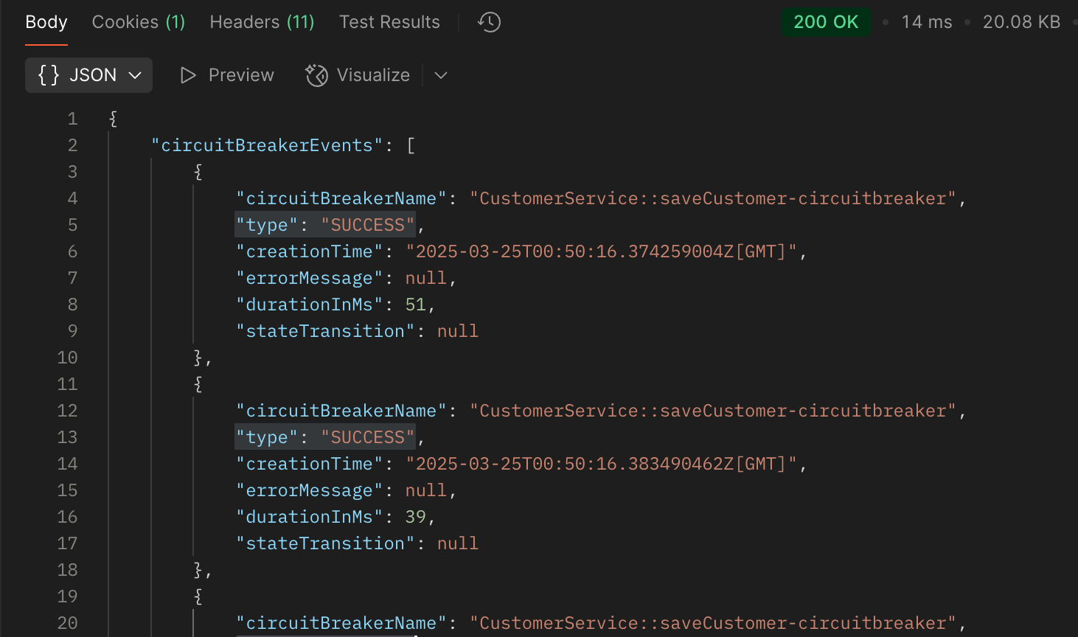
Resilience Patterns

Slide 19
Gatling Testing

Slide 20
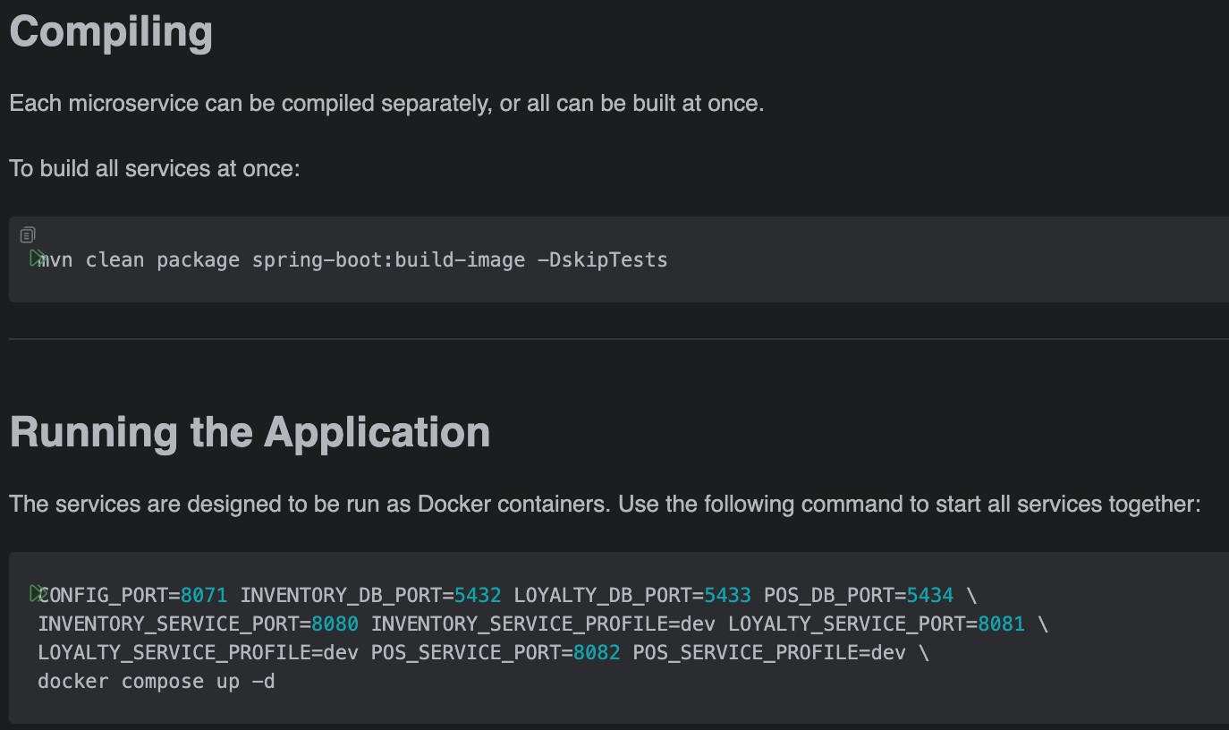
Running the Application
Visit https://github.com/Matt-Hays/csi-5347-course-project for more information.

Slide 21

Demonstration

Slide 22
Next Steps
Additional Gatling tests
Implement additional logging and monitoring

Slide 23
Thanks

